Slide 1
Fundamentals of Electric Transmission System Planning
Talk 4: Power Flow for Large-Scale Systems, Part 1
Prof. Tom Overbye
Dept. of Electrical and Computer Engineering
Texas A&M University
overbye@tamu.edu

Slide 2
Power Flow versus Load Flow
The power flow is one of the most widely used power system analysis tools
The terms “power flow” and “load flow” are used synonymously; I prefer the term power flow since the power “flows”, not the load
But both are commonly used, and have been commonly used in the power industry for at least 60 years
The classic paper in this area is by W.F. Tinney and C.E. Hart, “Power Flow Solution by Newton’s Method,” IEEE Power App System, Nov 1967
The power flow usage is not new with a 1956 paper by Ward and Hale titled “Digital Computer Solution of Power-Flow Problems”
In that 1956 paper there are a number of “load flow” references; a nice history of the power flow is given in an insert by Alvarado and Thomas in T.J. Overbye, J.D. Weber, “Visualizing the Electric Grid,” IEEE Spectrum, Feb 2001

Slide 3
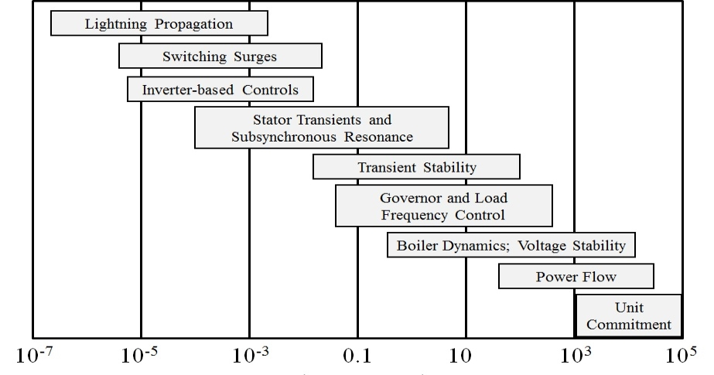
Challenge: Power System Time Frames
We’ll be here for this talk
Image source: P.W. Sauer, M.A. Pai, Power System Dynamics and Stability, 1997, Fig 1.2, modified

Slide 4
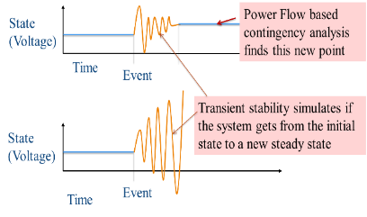
Static versus Dynamic Analysis
Statics versus dynamics analysis appears in many fields
An equilibrium point is a point at which the system model is not changing
Real systems are always changing, but over the time period of interest an unchanging system can be a useful approximation
Static analysis looks at how the equilibrium points change with respect to a change in the model
Power flow is a power system example
Dynamic analysis looks at how the system responds over time when it is perturbed away from an equilibrium point
GICs caused by GMDs are analyzed in the power flow

Slide 5
Static versus Dynamic Analysis, cont.
Values that change slowing (relative to the time frame of interest) can be assumed as constant
Power flow example is the load real and reactive values are assumed constant (sometimes voltage dependence is included)
Values that change quickly (relative to the time frame of interest) can be assumed to be algebraic
A generator's terminal voltage in power flow is an algebraic constraint, but not in transient stability
In power flow and stability the network power balance equations are assumed algebraic
In the power flow the control response of the human operator is considered a fast control whereas in dynamic analysis it is either slow or considered

Slide 6
Models and Their Parameters
Models approximate the generic behavior of an object (e.g., a resistor with V = RI)
The model’s parameters describe the behavior of a particular object
Models and parameters can be tightly coupled
The parameters for a particular model might have been derived from actual results on the object of interest, with the parameters tuned to match
For example, the resistance of an aluminum conductor is dependent on temperature and frequency, which might not be included in its model

Slide 7
Models and Their Parameters
Changing the model (even correcting an "incorrect" simulation implementation) can result in unexpected results!
Using a more detailed simulation approach, without changing the model, can also result in incorrect results
More detailed models are not necessarily more accurate
Not all parameters are created equal, and don’t need equal accuracy
Image shows estimated line resistance variation (time in seconds)

Slide 8
Per Phase Analysis of Three-Phase
Large-scale electrical systems are almost exclusively three-phase. Common analysis tools, such as power flow and transient stability, often assume balanced operation
Balanced three-phase systems could be modeled with a per phase approach
Balanced Three-Phase Theorem: If a three-phase system is balanced, all loads and sources are Y-connected, and there is no mutual inductance between the phases then
All neutrals at the same potential
Phases are completely decoupled

Slide 9
Linear versus Nonlinear Systems
A function H is linear if
H(α₁μ₁ + α₂μ₂) = α₁H(μ₁) + α₂H(μ₂)
That is
1) the output is proportional to the input
2) the principle of superposition holds
Linear Example: y = H(x) = c x
y = c(x₁+x₂) = cx₁ + c x₂
Nonlinear Example: y = H(x) = c x²
y = c(x₁+x₂)² ≠ (cx₁)² + (c x₂)²
Solving for GICs is linear and the power flow is nonlinear

Slide 10
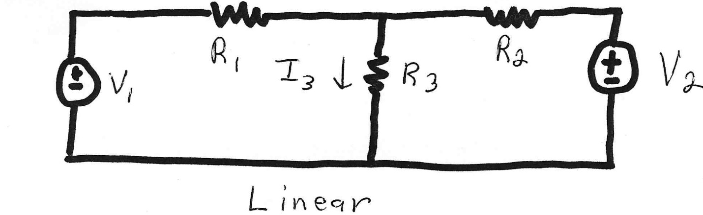
Linear Power System Elements

Slide 11
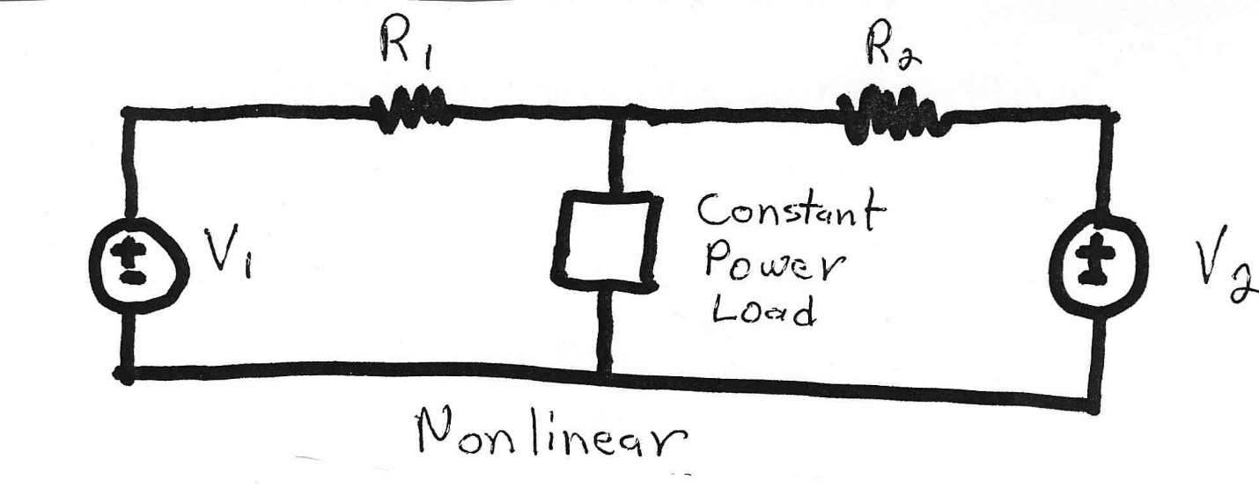
Mixed Linear and Nonlinear Models
Constant power loads and generator injections are nonlinear and hence systems with these elements can not be analyzed by superposition
Nonlinear problems can be very difficult to solve, and usually require an iterative approach

Slide 12
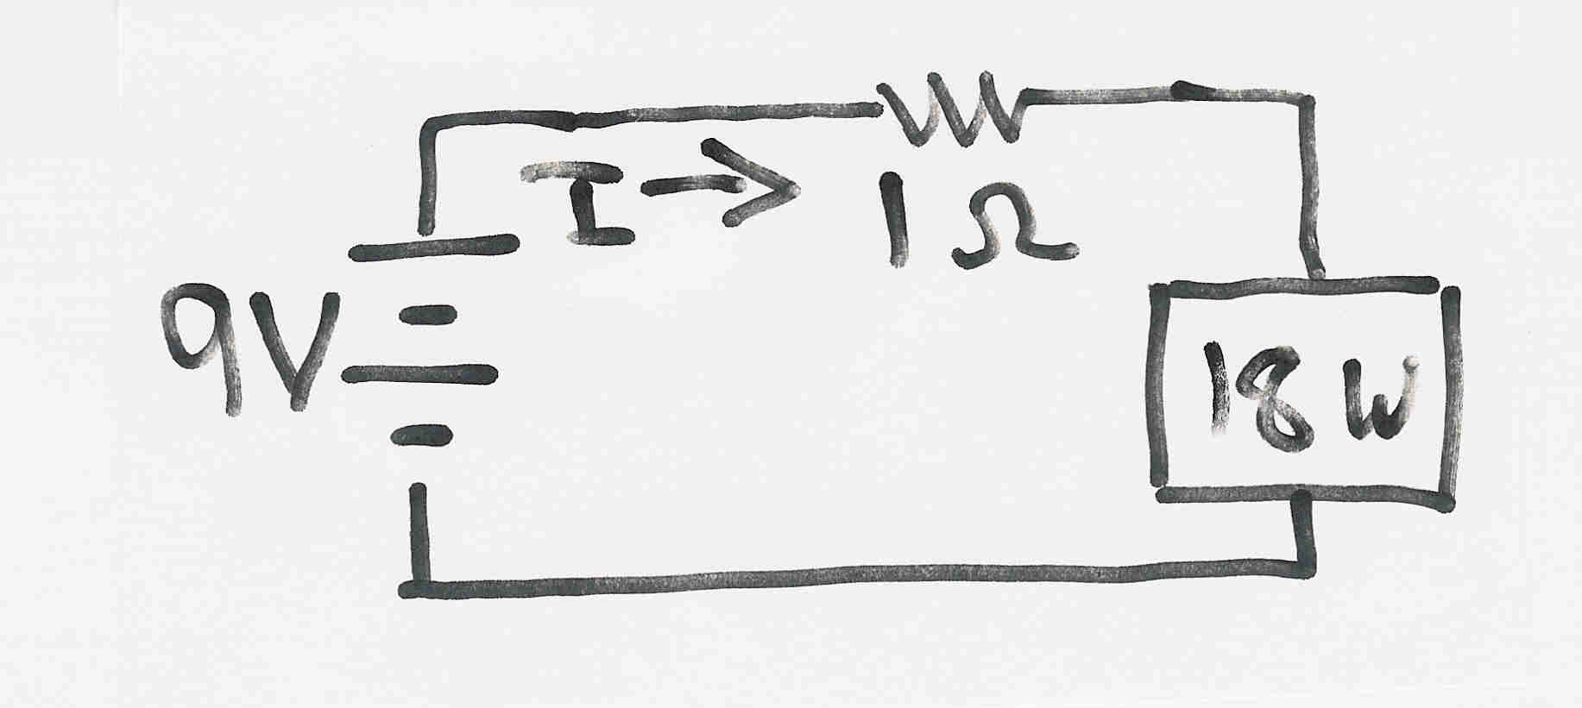
Multiple Solution DC Circuit Example
The dc system shown below has two solutions
where the 18 watt load is a resistive load
The maximum load is 20.25 W

Slide 13
Bus Admittance Matrix or Y_{bus}
A key step in solving the power flow is to create what is known as the bus admittance matrix, often call the Y_{bus}.
The Y_{bus} gives the relationships between the bus current injections, I, and the bus voltages, V I = Y_{bus} V
The Y_{bus} is developed by applying KCL at each bus in the system to relate the bus current injections, the bus voltages, and the branch impedances and admittances
The Y_{bus} is sparse for a large system (i.e. most elements are zero)

Slide 14
Power Flow Analysis
The goal of the power flow is to determine V, but since we do not know I we cannot directly use I = Y_{bus} V
Rather, we know the complex power being consumed by the load, and the power being injected by the generators plus their voltage magnitudes
So rather we setup and solve the power balance equations: S = V [Y_{bus} ]* V*

Slide 15
Power Balance Equations at Bus i

Slide 16
Slack (or Reference) Bus
We can not arbitrarily specify S at all buses because total generation must equal total load + total losses
We also need an angle reference bus.
To solve these problems we define one bus as the "slack" bus. This bus has a fixed voltage magnitude and angle, and a varying real/reactive power injection.
There is no slack bus in a real system; the frequency changes locally when the power supplied does not match the power consumed

Slide 17
Three Traditional Types of Power Flow Buses
There are three traditional types of power flow buses
Load (PQ) at which P/Q are fixed; iteration solves for voltage magnitude and angle.
Slack at which the voltage magnitude and angle are fixed; iteration solves for P/Q injections
Generator (PV) at which P and |V| are fixed; iteration solves for voltage angle and Q injection

Slide 18
Newton-Raphson Algorithm
Most common technique for solving the power flow problem is to use the Newton-Raphson algorithm
Key idea behind Newton-Raphson is to use sequential linearization

Slide 19
Newton-Raphson Method (scalar)

Slide 20
Newton-Raphson Method, cont’d

Slide 21
Newton-Raphson Example

Slide 22
Newton-Raphson Example, cont’d

Slide 23
Power Flow Variables

Slide 24
Newton-Raphson Power Flow Solution

Slide 25
Two Bus Newton-Raphson Example
For the two bus power system shown below, use the Newton-Raphson power flow to determine the voltage magnitude and angle at bus two. Assume that bus one is the slack and S_{Base} = 100 MVA.

Slide 26
Two Bus Example, cont’d

Slide 27
Two Bus Solved Values
The power flow then determines the bus 2 values (voltage magnitude and angle). Once these are known we can calculate all the other system values, such as the line flows and the generator reactive power

Slide 28
Low Voltage Power Flow Solutions
If the load is assumed to be truly constant power, then the power flow solutions actually have two solutions!
In reality at low voltages the load is not constant power; in practice these solutions can be avoid by the power flow switching to constant impedance at low voltages

Slide 29
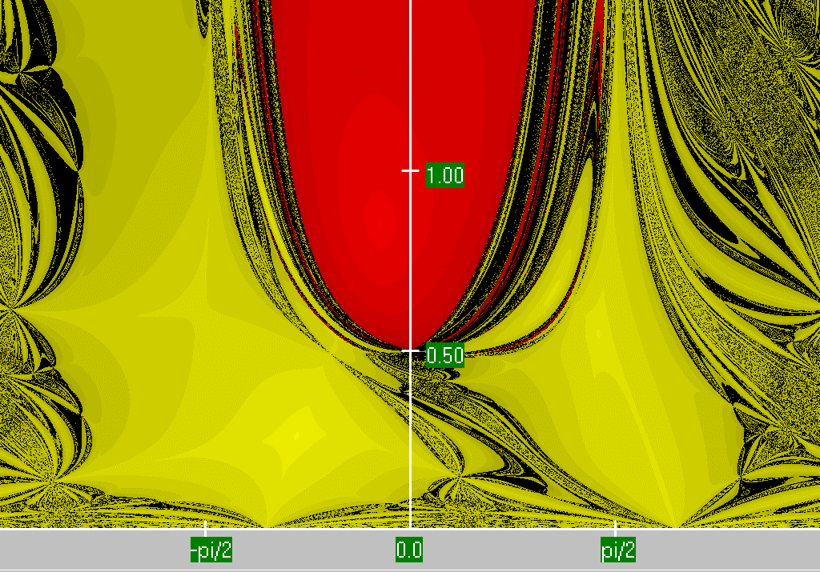
Two Bus Region of Convergence
Image shows the region of convergence for different initial guesses of bus 2 angle (x-axis) and magnitude (y-axis)
Red region converges to the high voltage solution, while the
yellow region converges to the low voltage solution

Slide 30
Low Voltage Solutions in Practice
Image shows planning study voltage contour (with red low) that had 65 energized 115,138, or 230 kV buses with voltages below 0.90 pu
The lowest 138 kV voltage was 0.836 pu; lowest 34.5 kV was 0.621 pu; case contained 42,766 buses; once a power flow solves to a low voltage solution, it tends to stay there fore subsequent changes!

Slide 31

PowerWorld Simulator
Commercial tool in actual use by utilities and others (1000+ customers in 70 countries)
Originally developed in 1996 by Prof. Overbye (formerly at University of Illinois, now at Texas A&M)
Originally designed to be well-suited to teaching students about power systems. Still has that capability while being full-featured for industry use
Strengths are user-friendliness, great abilities to show power system data and advanced visualization
There is a free student 42-bus version. We use the full (unlimited bus) version for hands-on in this class.
powerworld.com

Slide 32
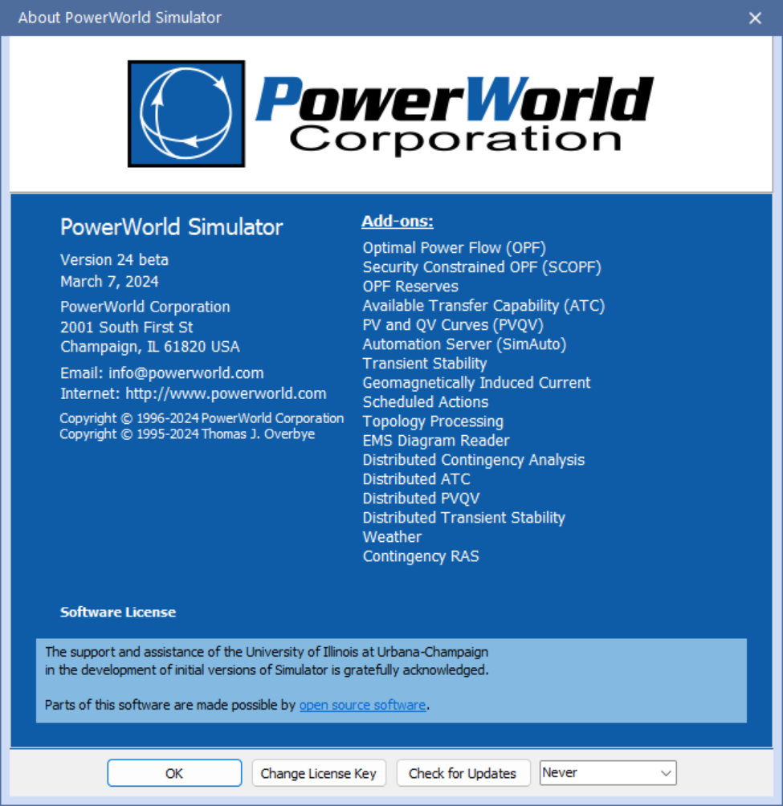
PowerWorld Version, Build Date and Add-Ons
Open PowerWorld Simulator; to see your version and build date select Window, About
Simulator stores information about the power system in *.pwb files and information about the onelines in *.pwd files
PowerWorld Simulator has the ability to read and write current and previous versions of its *.pwb and *.pwd files, but cannot read future versions

Slide 33
PowerWorld Simulator Basic Operation
PowerWorld Simulator (PowerWorld) has lots of power system simulation capabilities. Initially we’ll just use it to simulate the steady-state (quasi-static) operation of small electric grids
PowerWorld power system cases are stored using two file types: 1) a *.pwb file to store the power system itself, and 2) a *.pwd file to store the displays. Often when opening a *.pwb it automatically opens a pwd file
PowerWorld can run as a time-varying simulation; while this isn’t the most common way it is used, it is a good place to start
Start PowerWorld, and select File, Open Case and then use the dialog to select the case PSC_37Bus.pwb (in the Talk 4 directory)

Slide 34
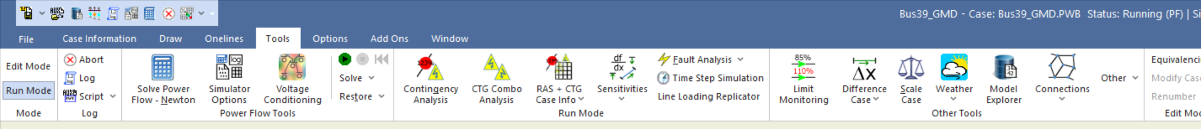
PowerWorld Simulator Basic Operation, cont.
PowerWorld has two main modes: Edit Mode and Run Mode; for this course we’ll only be using the Run Mode; if you do not start in Run Mode, just click on the button on the ribbon
To start solving the power flows, click on Tools, and then click on the green button with the black arrow; if you wish to solve a singe power flow select Solve, Solve Power Flow - Newton

Slide 35
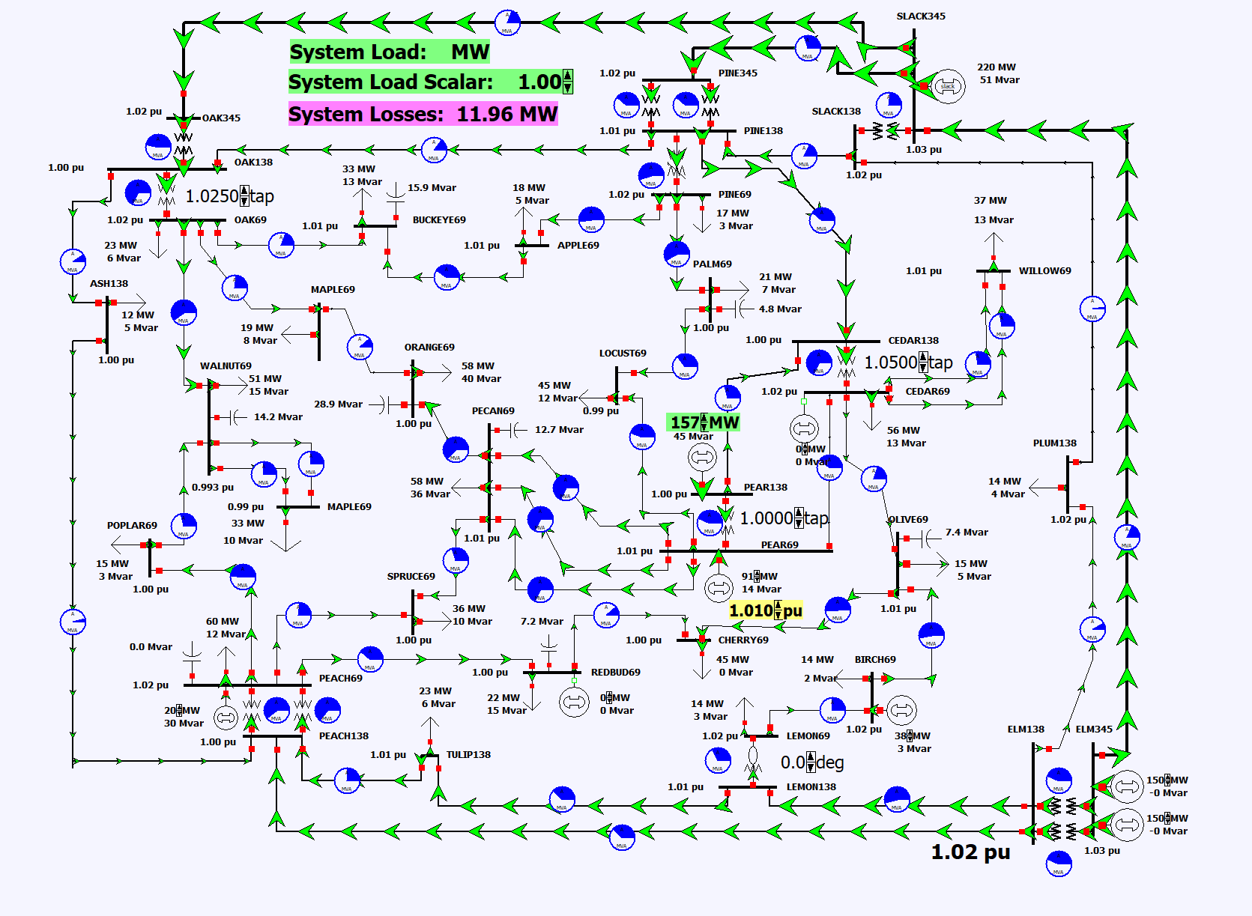
PowerWorld Simulator 37 Bus Power Flow
When the power flow is running the green “flow arrows” will be moving; click on any red circuit breaker to open a transmission line; or us the System Load button to uniformly scale the case load

Slide 36
What the Power Flow is Showing
The power flow is used to primarily determine 1) the amount of power flowing on each transmission line or transformer (generically sometimes called branches), and 2) the voltage magnitudes at each of the buses in the grid
It also shows some other values, like the reactive power outputs of generators
Good power system operation (given by NERC Standard TPL-001-4) says that in steady-state
The facility ratings shall not be exceeded (noting that “facilities” [e.g., branches]) can have multiple ratings in different situations
System steady state voltages and post-contingency voltage deviations shall be within acceptable limits

Slide 37
Learning (and Teaching) the Power Flow
There are two primary ways of teaching the power flow
Give the equations and solution methods, and focus on making sure the students know how to implement a power flow solution (i.e., coding it up); usually the power flow is only used on very small grids
Give some background on the problem formulation and solution approaches, but focus more on applications; the assumption here is people are going to be using the power flow, but not writing their own power flow
The focus here is on the second approach, with a learning by doing methodology
The size of an electric grid model is usually quantified by its number of buses; large grids models (like the North America Eastern Interconnect) have on the order of 80,000 buses

Slide 38
Power System Models, Cases and Islands
Before moving forward it is helpful to clarify a three terms that commonly come up related to power flow
In an engineering context the term “model”, as defined by Merriam-Webster is, “A system of postulates, data, and inferences presented as a mathematical description of an entity or state of affairs.”
Models for the same devices can vary in complexity, and (as noted by George Box), “All models are wrong but some models are useful.”
For example models for a resistor are V = R₀I or V = R₀(1 + 0.004*(T – T₀)) I
The values of the parameters (e.g. R₀ and T₀) then denote a particular model instance
In power flow the term model if often used more generically to indicate a particular electric grid with the associated parameters for the more static electric grid components (e.g., the transmission lines and transformers)

Slide 39
Power System Models, Cases and Islands, cont.
The term “case” is usually used to a particular electric grid operating point including all values needed to solve the power flow
There is a fuzzy line between what is relatively constant (e.g., the impedance of a transformer) and what commonly changes (e.g., the amount of bus load, whether a particular transmission line is in-service)
The term “base case” is often used to refer a starting case that is used for additional studies, such as with contingency analysis
The term “island” refers to a set of ac-interconnected buses.
A small power flow case usually has just a single island, though they can certainly have multiple islands.
The number of islands can change as a result of topology changes
Large electric grid cases often have multiple islands; islands often joined by HVDC.

Slide 40
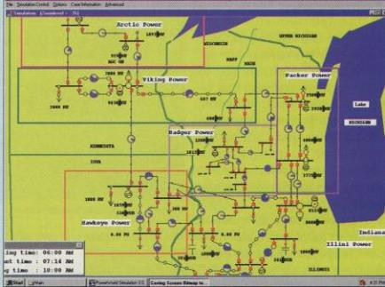
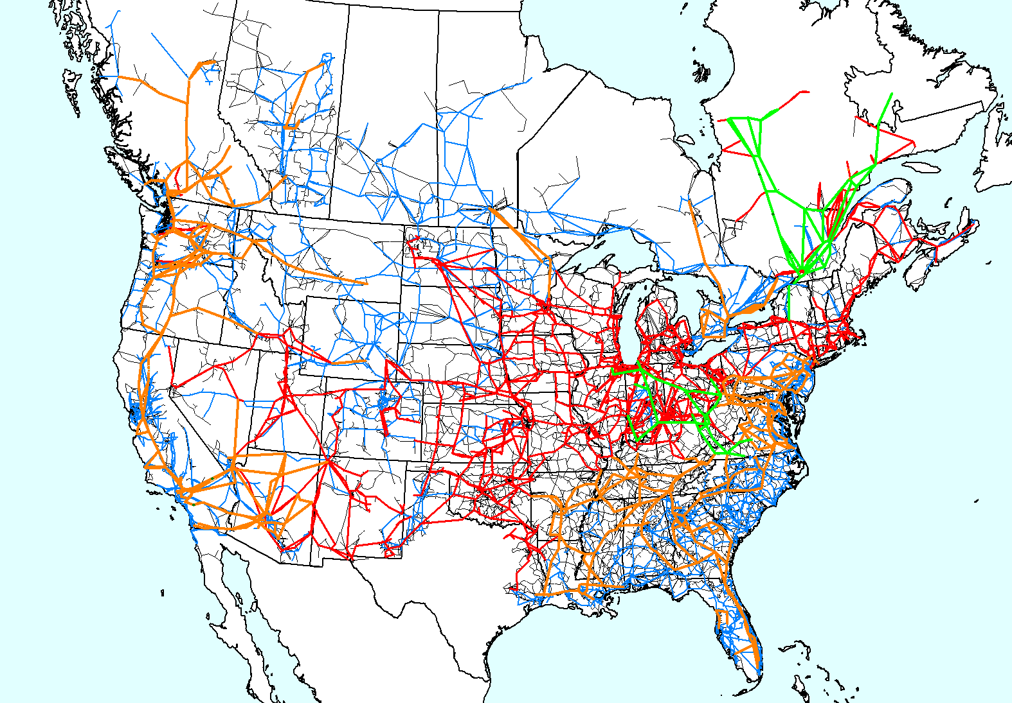
Showing Power Flow Results
Early PowerWorld Oneline
For small grids (up to maybe 100 buses) the results can be shown graphically on a oneline diagram
For larger cases oneline diagrams and other visualizations can still be very effective, but they are usually supplemented with other types of displays
In PowerWorld the main tabular displays are known as Case Information displays
120,000 Bus Model for East-West Interconnection Study

Slide 41
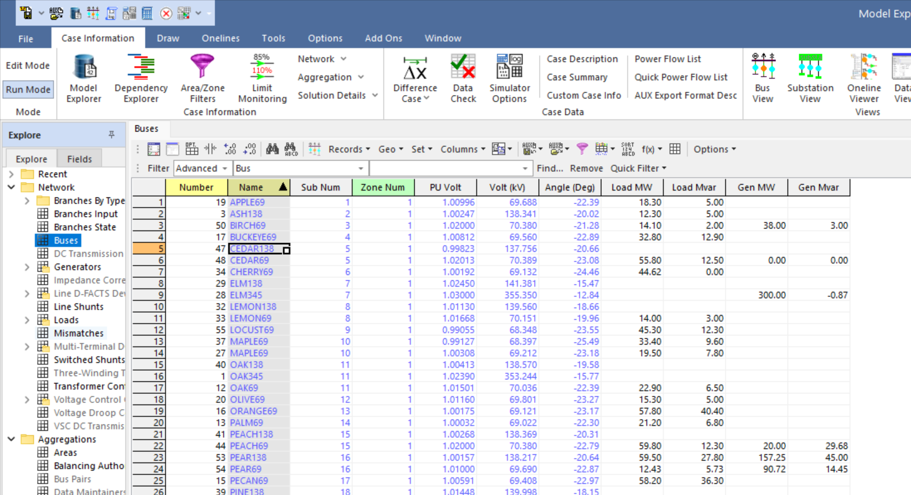
PowerWorld Case Information Displays
The Case Information displays can be accessed using the Case Information menu item
As an example, select Case Information, Network, Buses
To sort a column, left-click on the column header
Even more information is available by right-clicking on a device and selecting Show Dialog

Slide 42
Power Flow and Electric Grid Planning Challenges
The power flow models a grid at a specific instance in time (i.e., what is called a case). However, most everything associated with the case can change (though some values are more changeable than others) . For example,
The loading level
The generation
Branch statuses
New equipment
The planning challenge is to economically design a grid so that for all reasonably credible situations the grid works
This is becoming more challenging as the easily controllable generation of the past is being replaced by less controllable wind and solar

Slide 43
Example: Modeling a Change in Generation
The power flow is a steady-state analysis tool, so the assumption is total load plus losses is always equal to total generation
Generation mismatch is made up at the slack bus (also known as the reference bus or swing bus)
When doing generation change power flow studies one always needs to be cognizant of where the generation is being made up
Common options include system slack, distributed across multiple generators by participation factors or by economics

Slide 44
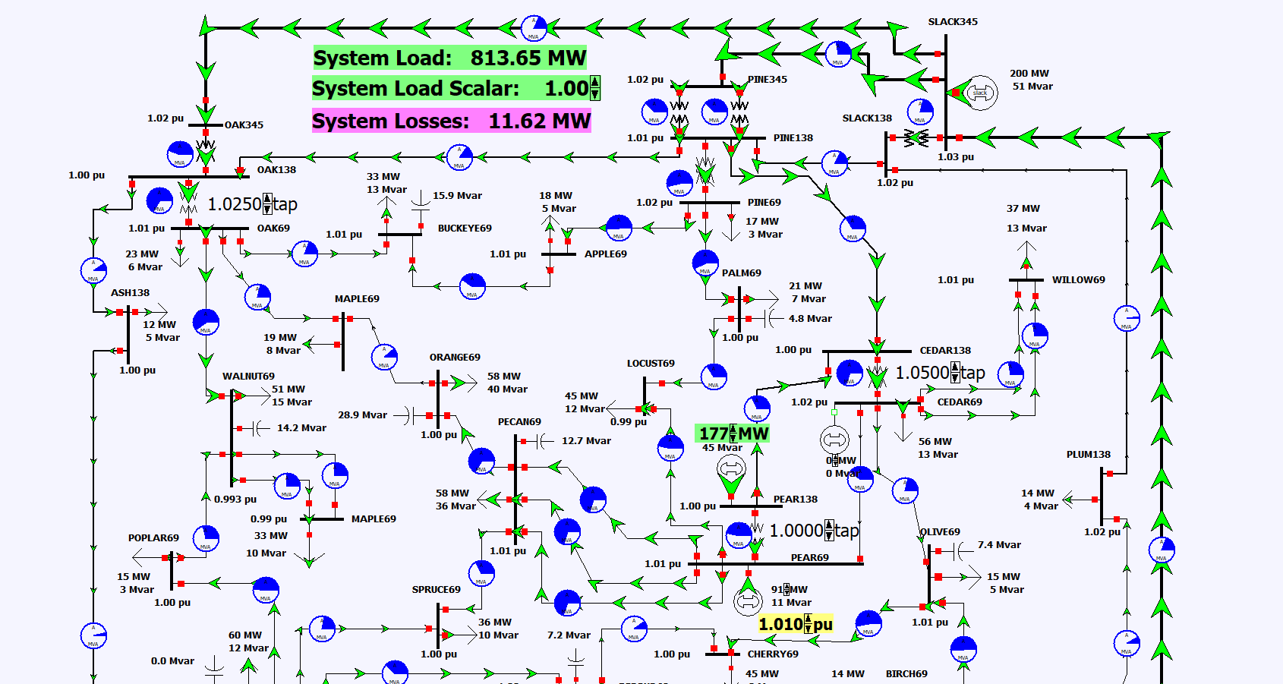
Generator Change Example 1: Actual Flows for 100 MW Change
Increase the generation at Pear138 by 100 MW (one click increases its output by 20 MW)
Notice a corresponding and opposite change at the slack bus

Slide 45
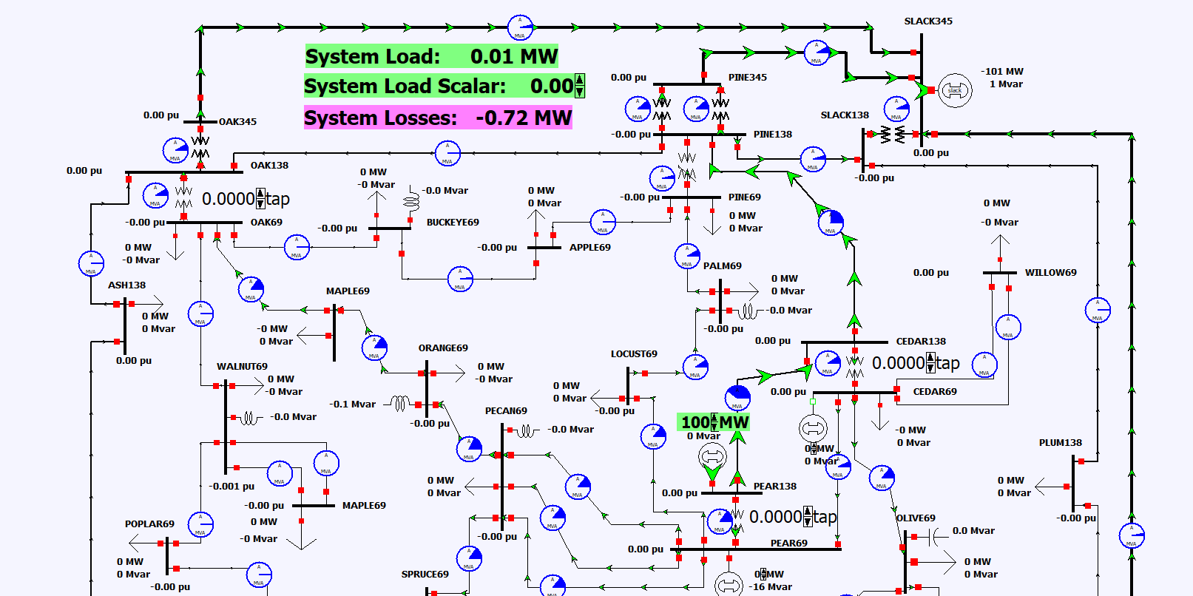
Generator Change Example 1: Difference Flows for 100 MW Change
To visualize just the change in the flows, before doing the change select Tools, Difference Case and then Set Present as Base. Then do the change and select Difference Mode
The slack decreased by -101 MW, with the extra -1 MW due to a change in the system losses.

Slide 46
Area Automatic Generation Control (AGC) Using Participation Factors
A more realistic way to allocate the change in generation is to assume it is picked up by a number of generators
One approach is to use generator participation factors, in which each generator picks up a specified proportion of the change
Generator min/max limits would be enforced
Area participation factor can be enabled by selecting Case Information, Aggregation, Areas and then toggling AGC Status to “Part AGC”

Slide 47
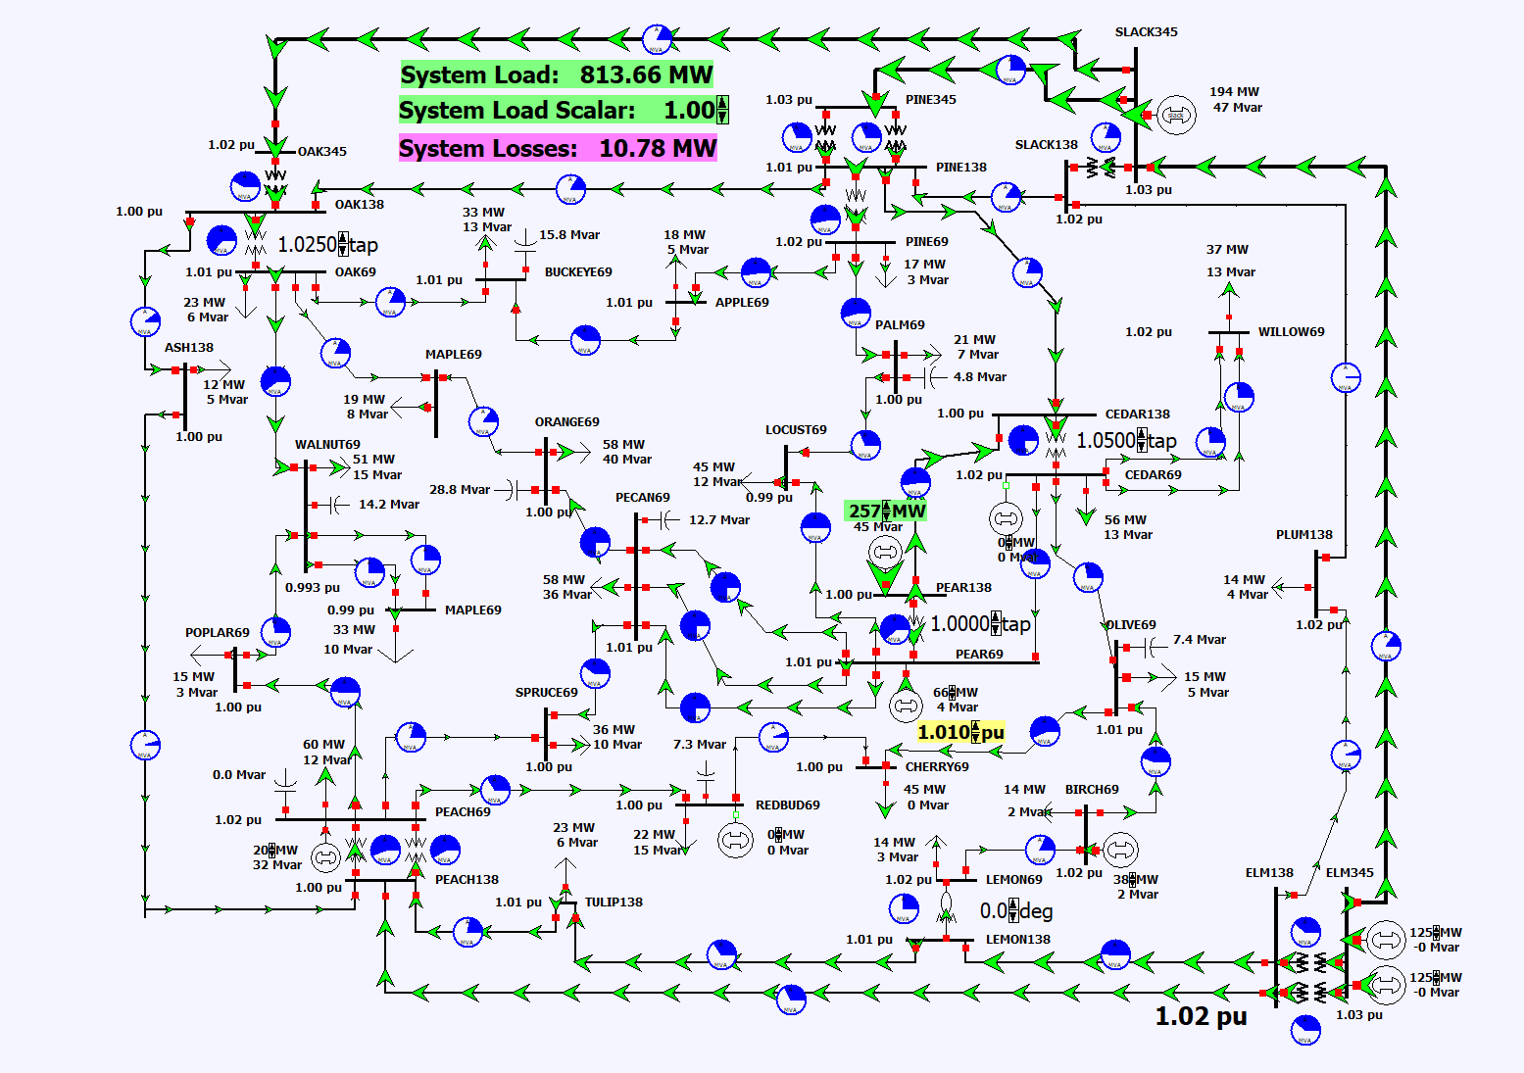
Generator Change Example 2: Using Area Participation Factors
Reload the case PSC_37Bus
Turn on area participation control
The values can be seen on Case Information, Generators; here they are all set to be proportional to each generator’s maximum MW value
To participate in area control each generator must be set on AGC (they are set off AGC when their output is manually changed); this value can be viewed/changed on the generator case info display
Use the difference mode to see how the generation changes as the load is changed

